Slide 1

The Court-House
Understanding the Indian Constitution.

Slide 2

ABOUT OUR GAME IDEA
Player acts as a lawyer and chooses what to speak out of given options, there is a situation abstract and law book to help him/her decide what to speak to win the Case.
Overview of Idea
Our Approach towards Idea Development
Schema Select
This is an Internet Browser based game (can be played on pc /mobile), its complete approach is based on HTML + CSS + JavaScript (+jQuery) and SVG Animations.
1
Digital Toy
Fight Against the crime with the Law Book.
Learn, decide and deliver your plea in the Court to win the case.
2
Indian Culture, History, Knowledge of India and Ethos (TYCH32)

Slide 3
GAME Description
Player is in the court as a lawyer, representing his/her client.
The case is explained as the game continues.
In the “Case Abstract”, a short summary of case lies, that can help the player throughout the story for making decisions.
Also the “Law Book” contains some laws from the Constitution of India related to the present case.
With the help of these two, and players own decision making skills, player is expected to choose from the given options which fits the law and situation accurately and deliver it to the jury.
In case player makes an incorrect decision, our primary storyline allows multiple possibilities that can occur in game.
Player gets points if it is correct and finally wins when enough evidences are presented or defended the client.
Note: there few mini-games while playing, like spot the difference in fake photographic evidence.

Slide 4
Ethos and values
Values of our idea:
This Game reflects a unique scenario of a virtual Indian court, specially meant for children to instill our Constitutional values in a fun and interactive way.
Children will understand the values of our constitution in a professional manner where they are fighting against the crime by choosing what is lawfully correct and ethically right.
This game depicts the consequences of ethical and non ethical or decisions made by accused/ lawyers.
A law book helps the player to learn about a few laws related to the story.
While teaching the constitution or civics, preferring this game to the students of educational institutes , they will be benefitted by learn while playing strategy. Surely, it will initiate interest in learning more about COI amongst the young ones.

Slide 5
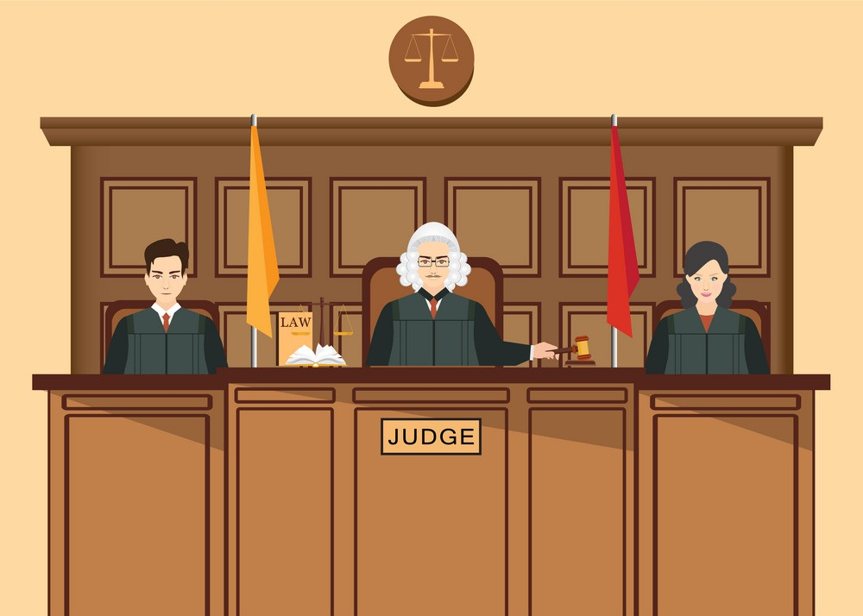

SOME CREATIVES
Law Book:
Section 300: The Act is commenced with the intention of causing bodily injury which…
Evidence report says…
Are we all ready to proceed?

Slide 6
How our Game idea is different
Interactive
Device Compatibility
Educative
Easy to add storylines
Audio and Cookie support
Multiple Possibilities

Slide 7
OUR APPROACH TO THE GAME
HTML/CSS
JavaScript/
jQuery
SVG animations
TOOLS
-Visual Studio Code
-Inkscape
-Adobe Photoshop
HTML and CSS form a basic structure that is common to most scenes during the game
Functioning of the game, like story building, audio speech of the characters and calculations are performed with js
Some movements of characters and vectored graphics shall be managed by SVG.

Slide 8
Manan GUpta
(CSE 3rd year, CXI)
COMPETITIONS
Skills/ Languages
-SIH 2020
-eBootathon 2020, REC Banda (Silver)
-IISF 2020
-Dynamic Web Development
-C, Java programming
-IOT
-JavaScript, jQuery, ReactJs
-Servlets + JSP + AJAX
-HTML/CSS + SVG graphics and animations
-MySQL
Projects-
-Railways Bus Management System
-Online Assessment with image processing
-Boolean Retrieval Model (parallel processing)
-Smart Vehicle security
-Chemistry Lab Simulation

Slide 9
Ananya Sharma
(CSE 3rd year, CXI)
Experience-
Skills/ Languages
- Sparks foundation Data analytics
internship
-Frontend Web Dev + Machine Learning (Deep Learning)
-C, C++, Python programming
-NLP
-JavaScript, ReactJs, Django
-HTML/CSS
-SQL
Projects-
-Amazon Clone (ReactJs, Firebase)
-TinDog WepApp (ResNet50)
-Twitter Sentiment Analysis
-Titanic Survivals –Kaggle (ML)

Slide 10
Samarpan Jain
(CSE 3rd year, UDYAT Coordinator)
COMPETITIONS-
Skills/ Languages
-IISF
-AICTE fellowship program
-Web Development (HTML/CSS/Js)
-Python (backend) programming
-C programming
-MySQL/ Sqlite
Projects-
-Innovation Cell website
-Blogging Website
-Doctor Cure for kidney diagnosis

Slide 11
SamarTH Anand
(CSE 3rd year, UDYAT Vice-Secretary)
COMPETITIONS-
Skills/ Languages
-SIH 2020
-eBootathon 2020, REC banda (Gold)
-IISF 2020
-AKTU poster making competition
-Machine Learning
-C, Python programming
-Javascript, jQuery
-HTML/CSS
-SVG animations
Projects-
-Custom object detection (using YOLO)
-Sentiment analysis of twitter data
-Real Time Attendance Monitoring System

Slide 12

Team Profile
Team Objective
To build a game that reflects values of the Constitution of India. To build the sense of law and justice among children by developing their interest and a will to learn more about laws in India.
Team Details
Team Excellence
Team Name: Excellence
Team Leader: Manan Gupta, 9758183355, manan.gupta.cs.2018@miet.ac.in
Team member: Ananya Sharma, 9536873941, ananya.sharma.cs.2018@miet.ac.in
Team member: Samarth Anand, 7060226350, samarth.anand.cs.2018@miet.ac.in
Team member: Samarpan Jain, 8941837344, samarpan.jain.cs.2018@miet.ac.in
Team Size: 04
Mentors: Dr. Mukesh Rawat, Dr. Vimal Kumar
College: Meerut Institute of Engineering and Technology
Type: Digital

